Slide 1

Statistics and Probability for Data Analyis
Understanding the Foundations of Data Science

Slide 2

Introduction
• What is Statistics?
• What is Probability?
• Importance in Data Analysis

Slide 3

What is Statistics?
Scenario 1: Student Performance
A teacher analyzes exam scores to find: ✅ Average score (Mean) ✅ Most common score (Mode) ✅ Score variation (Standard Deviation)

Slide 4

What is Statistics?
Scenario 2: Business Sales Analysis
A company checks sales before & after a campaign: 📊 Sales increase? Continue marketing 📊 Unpredictable sales? Investigate further 📊 Outliers? Identify unusual spikes

Slide 5

What is Statistics?
Scenario 3: Vaccine Effectiveness
Scientists test a vaccine with 1,000 volunteers: 🩺 Group A (Vaccine) vs. Group B (Placebo) 🩺 Fewer infections in Group A? Vaccine works! 🩺 Same results? Rethink the formula

Slide 6

Descriptive Statistics
• Mean, Median, Mode
• Variance, Standard Deviation
• Data Visualization: Histograms, Boxplots, Scatter Plots

Slide 7
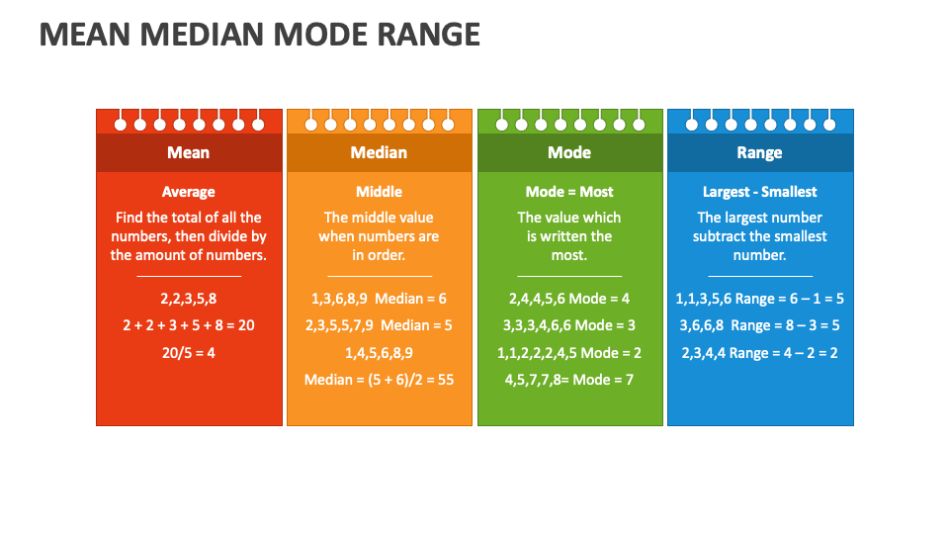
Mean, Median, Mode

Slide 8
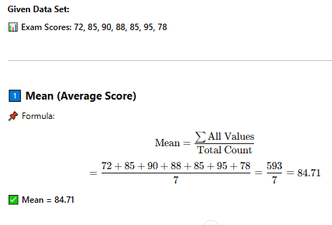
Mean

Slide 9
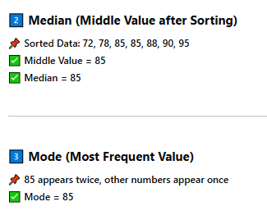
Median, Mode

Slide 10
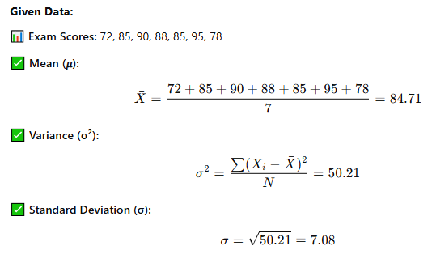
Variance, Standard Deviation
Interpretation: A standard deviation of 7.08 means most scores are within 7.08 points of the mean (84.71).

Slide 11
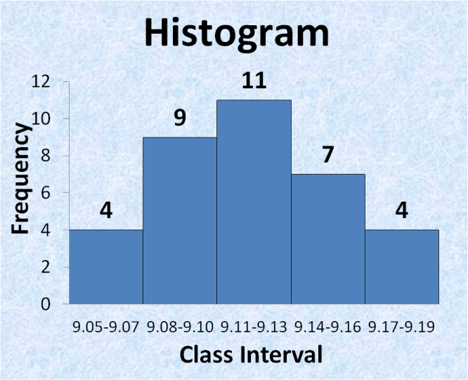
Histogram - Distribution of Data

Slide 12
Boxplot - Summary of Data Spread

Slide 13
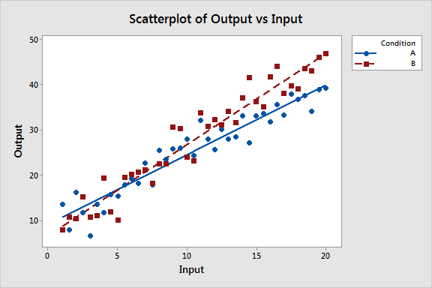
Scatterplot - Relationship Between Two Variables

Slide 14

Probability Basics
• Events, Sample Space, Probability Rules
• Conditional Probability & Bayes' Theorem
• Real-world Examples

Slide 15
Events & Sample Space
1️⃣ Events & Sample Space 🎲
✅ Sample Space (S): The set of all possible outcomes. ✅ Event (E): A subset of the sample space.
📌 Example (Rolling a Die 🎲):
Sample Space (S) = {1, 2, 3, 4, 5, 6}
Event (E): Getting an even number = {2, 4, 6}

Slide 16
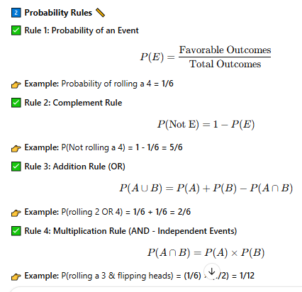
Probability Rules

Slide 17
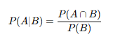
Conditional Probability (P(A | B))
✅ Definition: Probability of event A occurring given that event B has already occurred.
📌 Formula:
👉 Example:
Event A: A student passes a final exam.
Event B: The student attended all classes.
P(A | B): Probability that a student passes given they attended all classes.

Slide 18
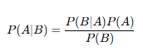
Bayes' Theorem (Reverse Probability)
✅ Definition: Used to update probabilities based on new evidence.
📌 Formula:
👉 Example: Medical Test for Disease
P(Disease) = 0.01 (1% have the disease)
P(Positive Test | Disease) = 0.95 (95% accurate test)
P(Positive Test | No Disease) = 0.05 (5% false positive)
P(Positive Test) = P(Positive | Disease) P(Disease) + P(Positive | No Disease) P(No Disease)
Using Bayes' Theorem → Updated probability that a person has the disease given a positive test!

Slide 19
Real World Examples
Conditional Probability (P(A | B))
✅ Spam Detection: P(Email contains "lottery" | It is spam) → Helps filter spam. ✅ Weather Forecasting: P(Rain | Cloudy morning) → Higher chance of rain.
Bayes' Theorem (Updating Probabilities)
✅ Medical Diagnosis: P(Disease | Positive Test) → Adjusts for false positives. ✅ Fraud Detection: P(Fraud | Alert) → Reduces false alarms in banking.
💡 Insight: Used in AI, finance, healthcare, and weather prediction!

Slide 20
Probability Distributions
Discrete: Bernoulli, Binomial, Poisson
Continuous: Normal, Exponential
Central Limit Theorem

Slide 21
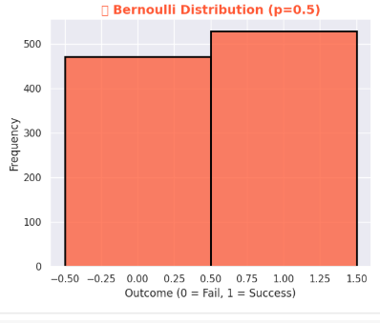
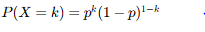
Bernoulli Distribution
✅ Single trial with two outcomes (Success = 1, Failure = 0). ✅ Example: Tossing a coin (H = 1, T = 0). ✅ Formula:

Slide 22
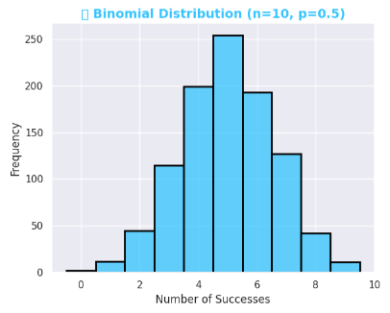

Binomial Distribution
✅ n independent Bernoulli trials → Count of successes.
✅ Example: Number of heads in 10 coin flips.
✅ Formula:
Mean: 𝑛𝑝
Variance: 𝑛𝑝(1−𝑝)

Slide 23
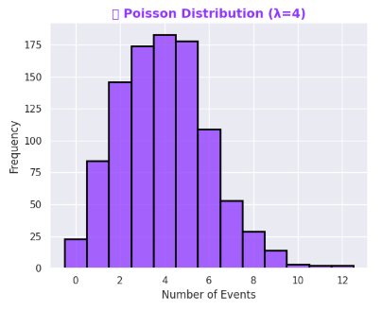

Poisson Distribution
✅ Events over fixed time/space (rate λ).
✅ Example: Customer calls per hour.
✅ Formula:
✅ Mean & Variance: λ

Slide 24
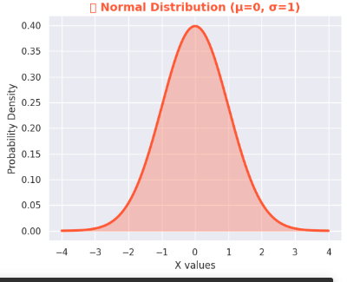
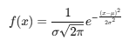
Normal Distribution (Gaussian)
✅ Symmetric, bell-shaped curve. ✅ Mean (μ) & Standard Deviation (σ) control the shape. ✅ Example: Heights of people, IQ scores. ✅ Formula:

Slide 25
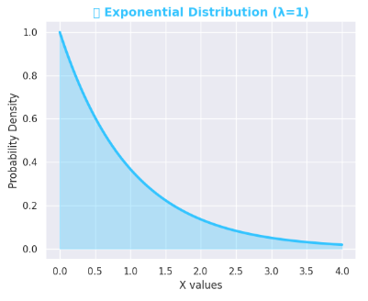
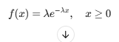
Exponential Distribution
✅ Models time between events in a Poisson process. ✅ Parameter λ (rate) determines the speed of decay. ✅ Example: Time between customer arrivals, radioactive decay. ✅ Formula:

Slide 26
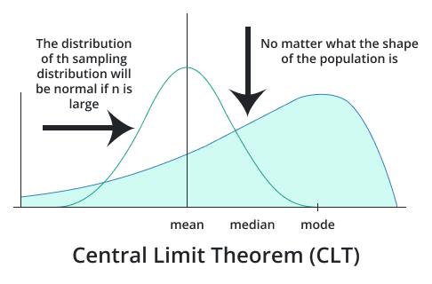
Central Limit Theorem

Slide 27

Inferential Statistics
• Sampling Methods
• Hypothesis Testing (p-values, errors)
• Confidence Intervals

Slide 28
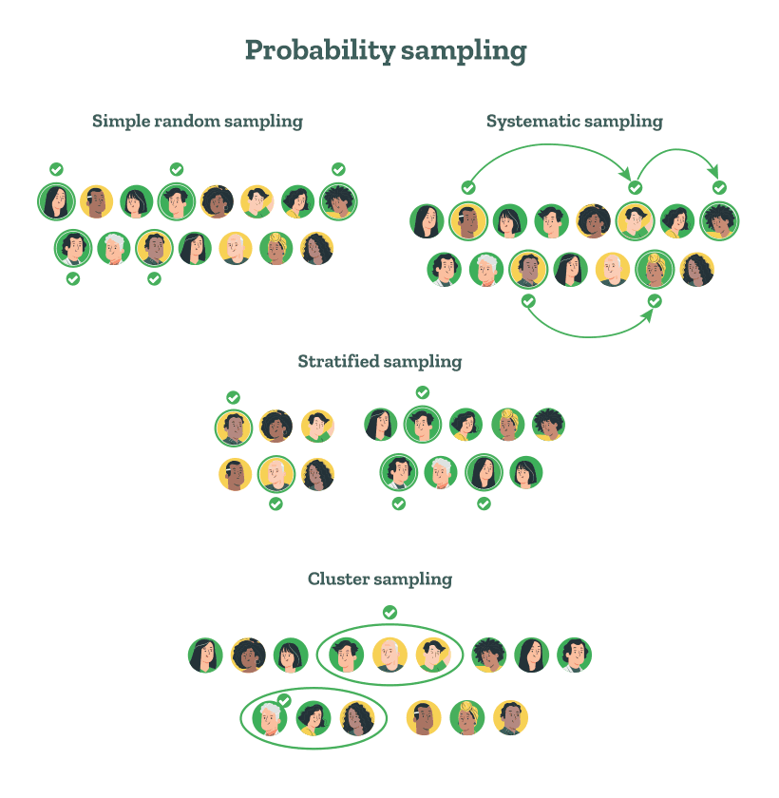
Sampling Methods

Slide 29
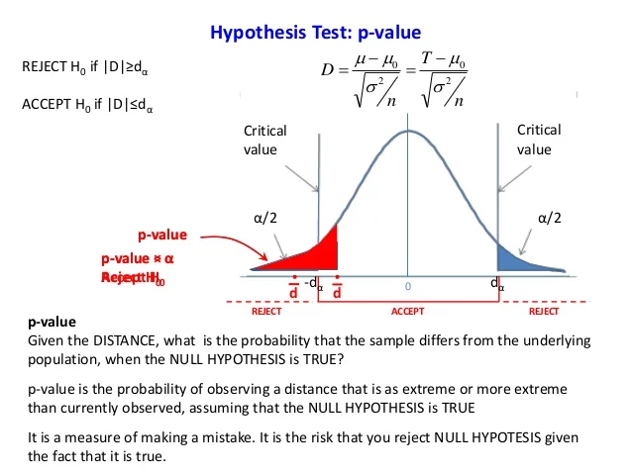
Hypothesis Testing

Slide 30
Hypothesis Testing
Scenario: Does a New Study Technique Improve Exam Scores?
Imagine you are a professor conducting research on a new study technique. You want to test whether students using this new technique score higher on their exams compared to those who follow the traditional method.
Step 1: Define Hypotheses
Null Hypothesis (H₀): The new study technique does not improve exam scores (no significant difference).
Alternative Hypothesis (H₁): The new study technique improves exam scores (significant increase).

Slide 31
Hypothesis Testing
Step 2: Collect Data
You randomly select 30 students and divide them into two groups:
Group A (Traditional Method) → 70% average score
Group B (New Study Technique) → 75% average score
Step 3: Choose a Significance Level (α)
Set α = 0.05 (5% chance of rejecting the null hypothesis incorrectly).
Step 4: Perform a Hypothesis Test
Conduct a t-test to compare the mean scores of both groups.
Compute the p-value (probability of obtaining these results if H₀ is true).

Slide 32
Hypothesis Testing
Step 5: Interpret the Results
If p-value < 0.05, reject H₀ → The new study technique significantly improves scores. ✅
If p-value ≥ 0.05, fail to reject H₀ → No strong evidence that the new technique is better. ❌
Conclusion
If the test shows statistical significance (p < 0.05), you can confidently recommend the new study technique for students to achieve higher scores. 🎯📚

Slide 33
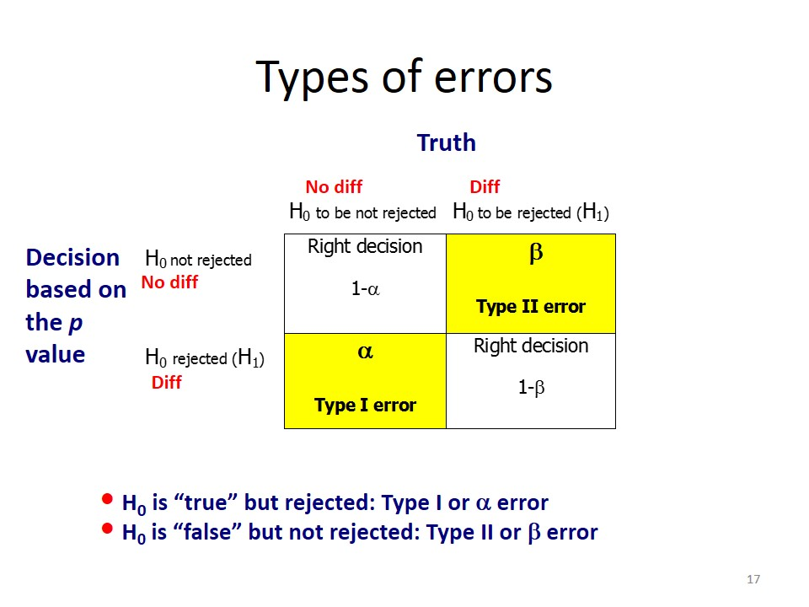
Hypothesis Testing

Slide 34
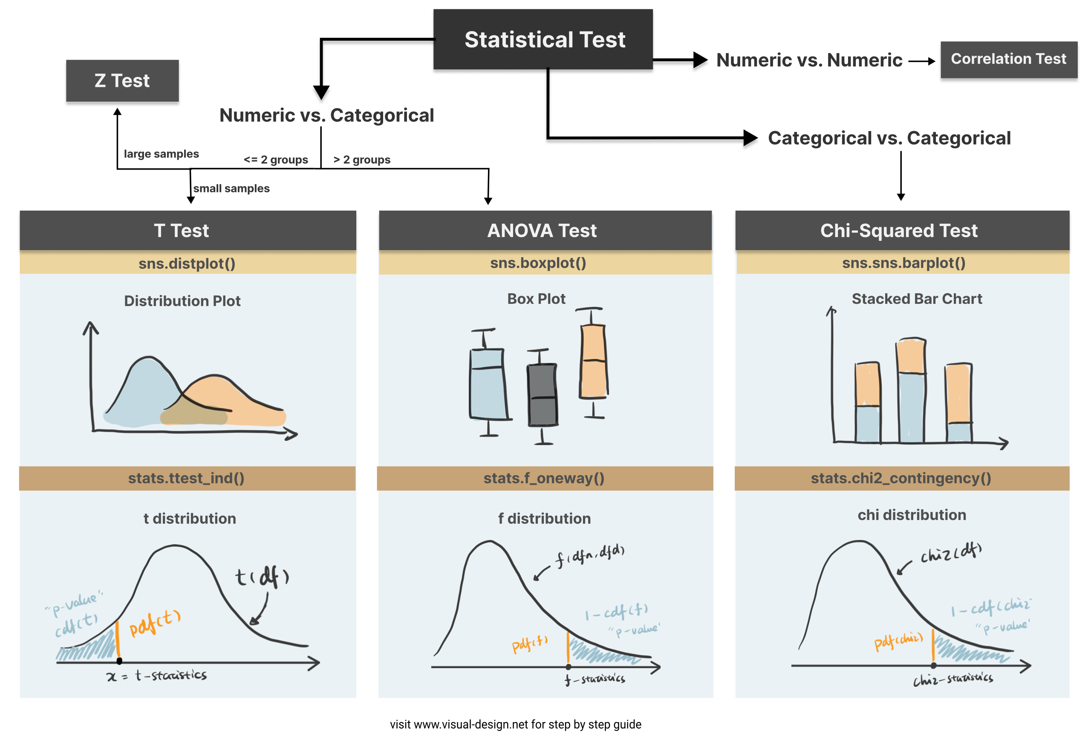
Hypothesis Testing

Slide 35
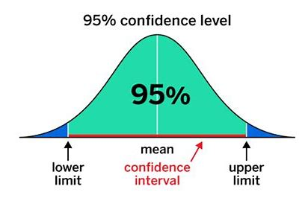
Confidence Interval

Slide 36

Regression & Correlation
• Correlation vs. Causation
• Linear & Logistic Regression
• Application in Data Science

Slide 37
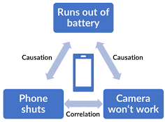
Correlation vs. Causation

Slide 38
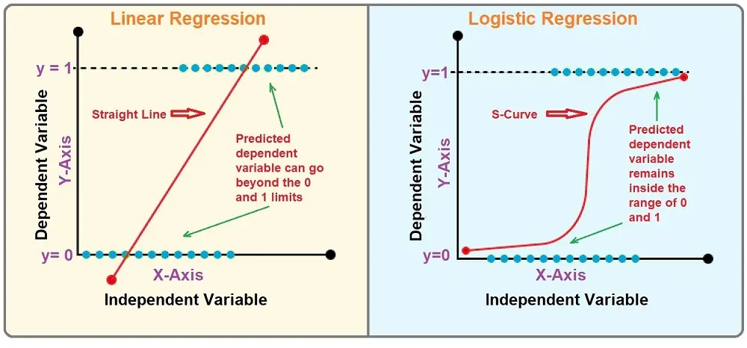
Linear & Logistic Regression

Slide 39
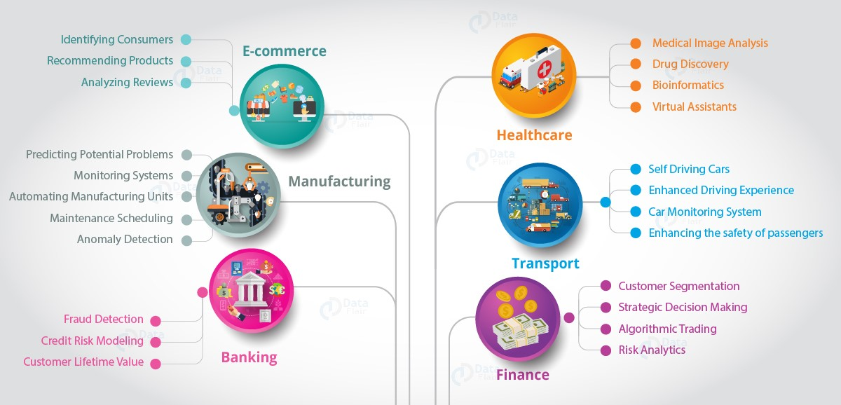
Application in Data Science

Slide 40
Machine Learning
• Bias-Variance Tradeoff
• Feature Scaling (Normalization vs. Standardization)
• Model Evaluation Metrics

Slide 41
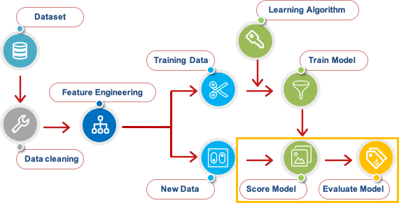
Machine Learning Approach

Slide 42
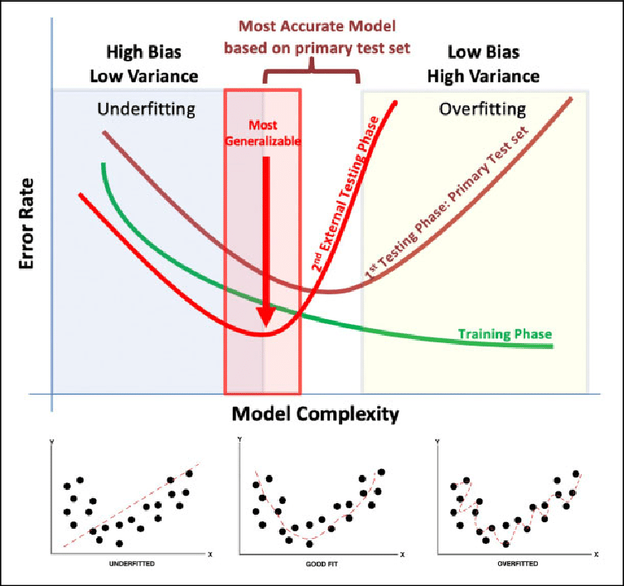
Bias and Variance

Slide 43
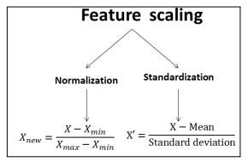
Feature Scaling

Slide 44
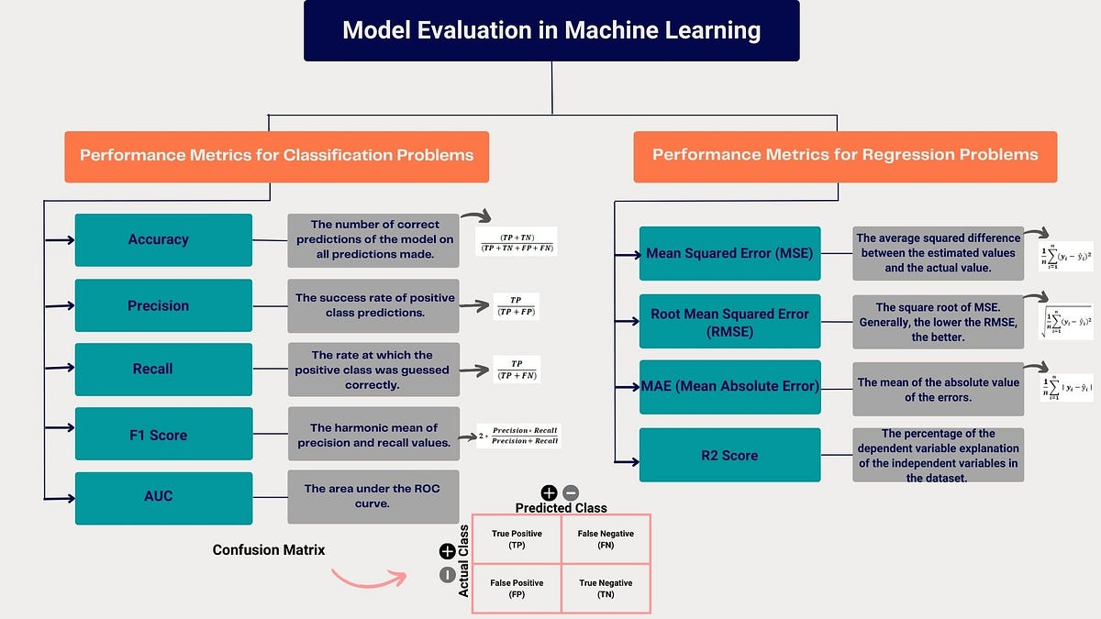
Model Evaluation Metrics

